Slide 1
Driving the Price
Mason James, Joe McKinstry, Charlie Rolecek, Sean Marren, and Ryan Marques

Slide 2
Overview
Background
High percentage of used cars being sold at a premium
Business Goal
Goal for used car dealership looking to set fair prices to attract customers
Data and Description
Use of used car data, a brief description of the data, and preparation techniques
Data Analysis
Visualization of our results using plots and graphics
Methods
Description of data mining methods used and evaluation of our models
Conclusion and Future Steps
Forward thinking recommendations for used car dealerships looking to attract customers using fair pricing methods
Notes:
Background
Data Analysis
Recommendation/Findings on Data
Conclusion

Slide 3
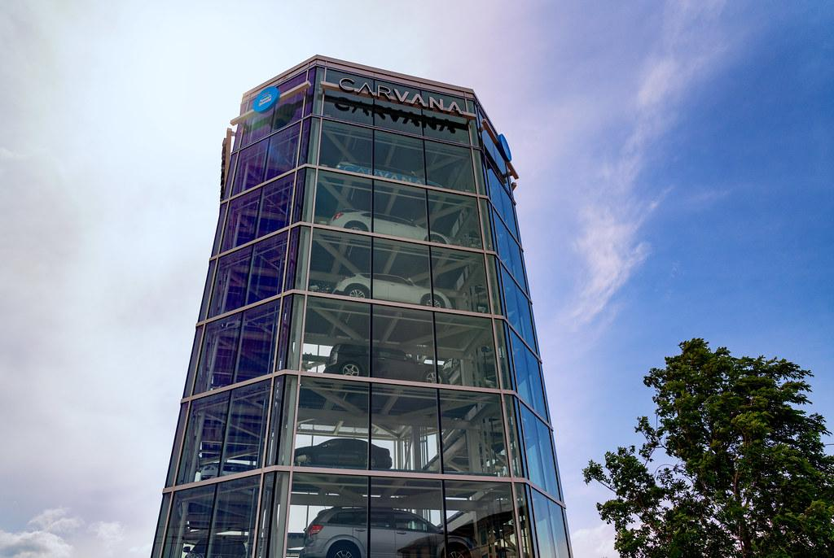
Background
Consumers have been paying ~$10k more on average than they should for used cars
Carvana is the fastest growing online used car dealer in the United States
Carmax, a competitor, generates 6 billion more in revenue per year
Background
Business Goal
Data and Description
Data Analysis
Methods
Conclusion
Notes:
https://www.cnbc.com/2022/07/21/consumers-paying-average-10000-above-normal-prices-for-used-cars.html

Slide 4

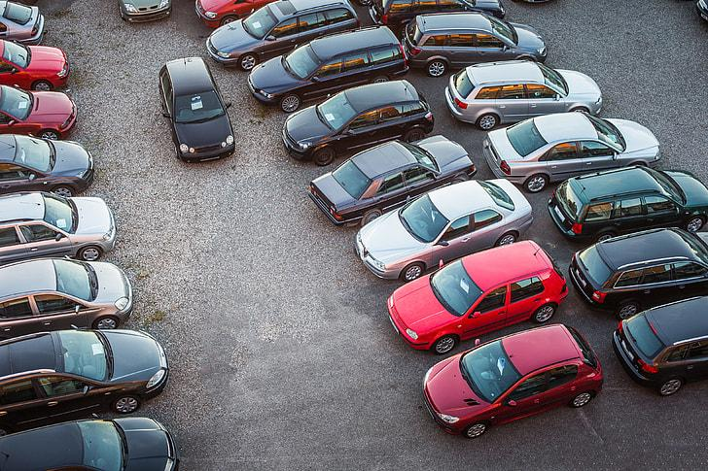
Business Goal
When purchasing used cars mileage, brand, and production year come to the forefront of people’s minds. Our goal however, is to discover what other factors affect the price of a vehicle in a used car market. Carvana can use our results to more accurately price and better market their vehicles.
Background
Business Goal
Data and Description
Data Analysis
Methods
Conclusion

Slide 5
Data and Description
Total Cars
2000 (Ford, Toyota, Honda, Lexus, etc.)
Categorical Features
10 (Model, Production Year, Color, etc.)
Numeric Features
6 (Engine Volume, Doors, Cylinders, Airbags, etc.)
Background
Business Goal
Data and Description
Data Analysis
Methods
Conclusion
Notes:
Original dataset

Slide 6
Data Preparation
Setting Target Variable
Data Cleaning
Variable Transformation
1
2
3
Background
Business Goal
Data and Description
Data Analysis
Methods
Conclusion

Slide 7
Data Exploration and Analysis
Background
Business Goal
Data and Description
Data Analysis
Methods
Conclusion

Slide 8
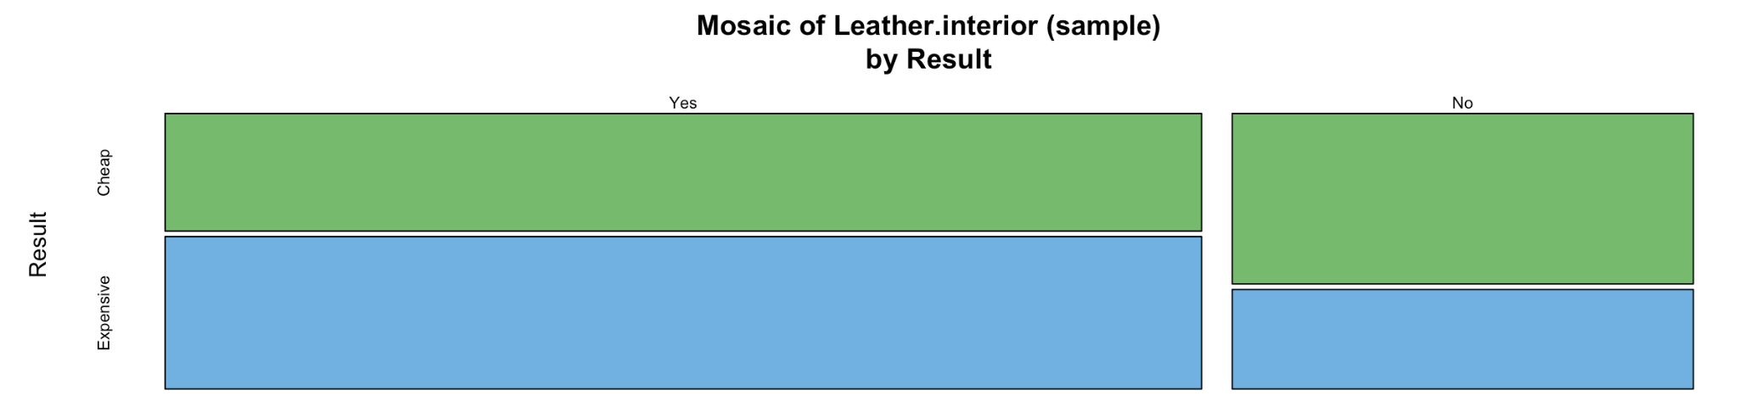
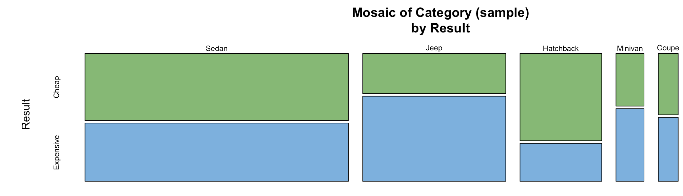
Background
Business Goal
Data and Description
Data Analysis
Methods
Conclusion

Slide 9
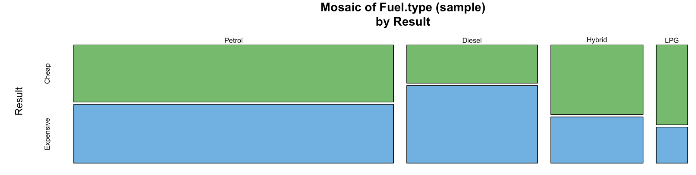
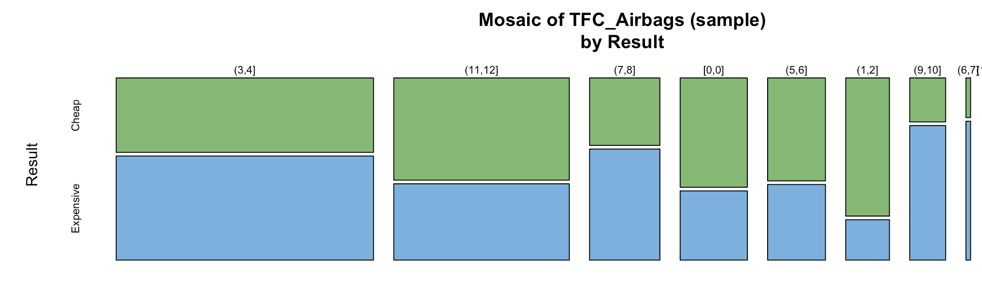
Background
Business Goal
Data and Description
Data Analysis
Methods
Conclusion

Slide 10
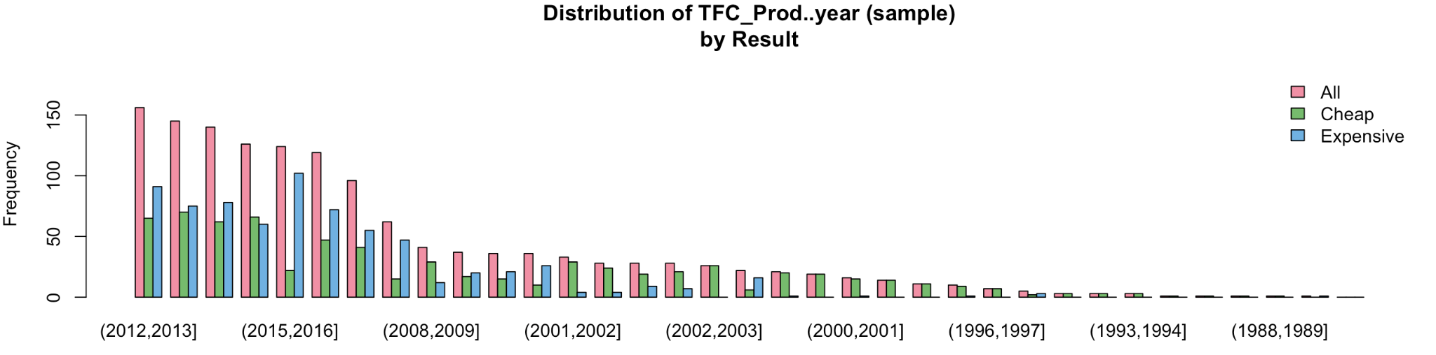
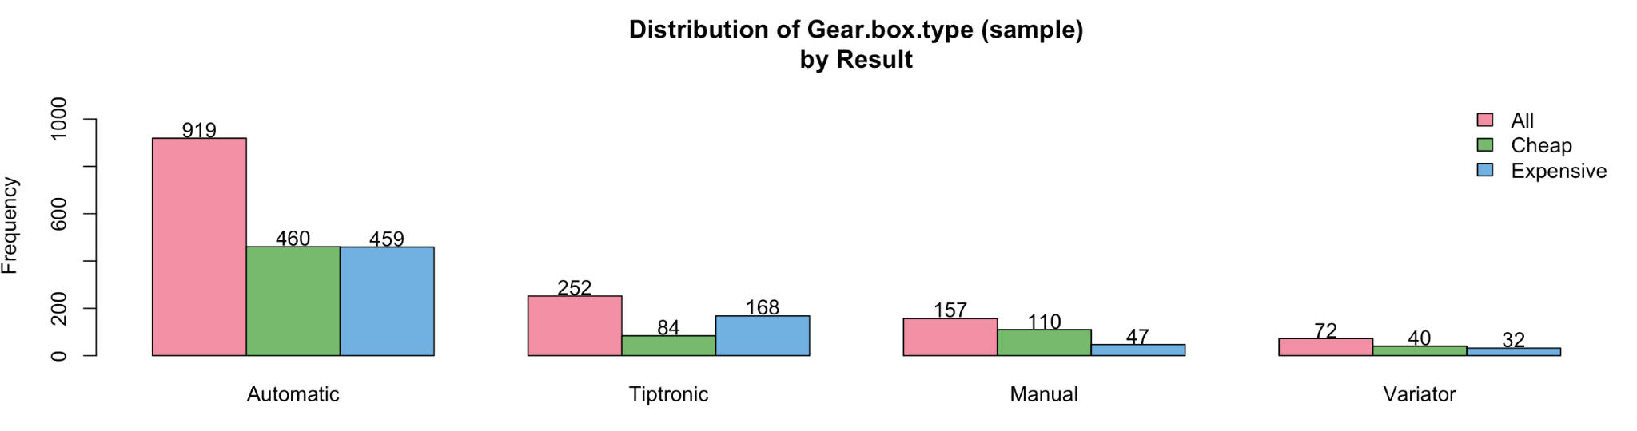
Background
Business Goal
Data and Description
Data Analysis
Methods
Conclusion

Slide 11
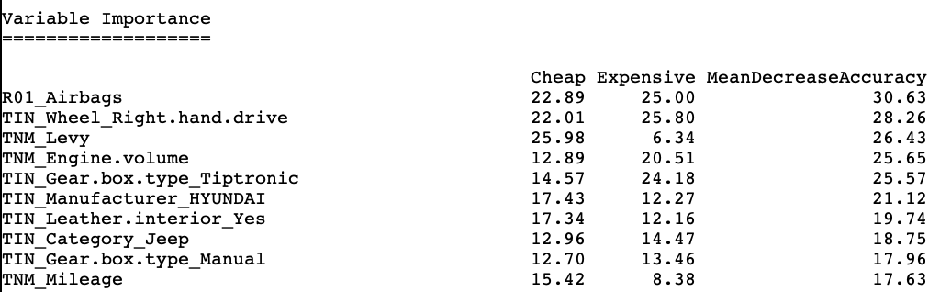
Data Exploration and Analysis
Random Forest
Background
Business Goal
Data and Description
Data Analysis
Methods
Conclusion

Slide 12
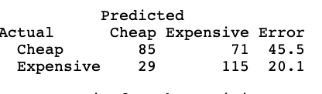
Data Exploration and Analysis
Decision Tree
Accuracy | 67%
Precision | 62%
Recall | 80%
Background
Business Goal
Data and Description
Data Analysis
Methods
Conclusion

Slide 13
Data Exploration and Analysis
AUC Comparison
SVM | 0.79
Decision Tree | 0.71
Random Forest | 0.85
Background
Business Goal
Data and Description
Data Analysis
Methods
Conclusion

Slide 14
Methods, Results, and Evaluation
Methods
Random Forest, Decision Tree, SVM
Results
Leather interior, vehicle type, fuel type and airbags are some of the most important features that determine the price of a used car
Evaluation
Graphic representation using mosaics and bar charts Numeric representation using accuracy, precision, and recall
Background
Business Goal
Data and Description
Data Analysis
Methods
Conclusion

Slide 15
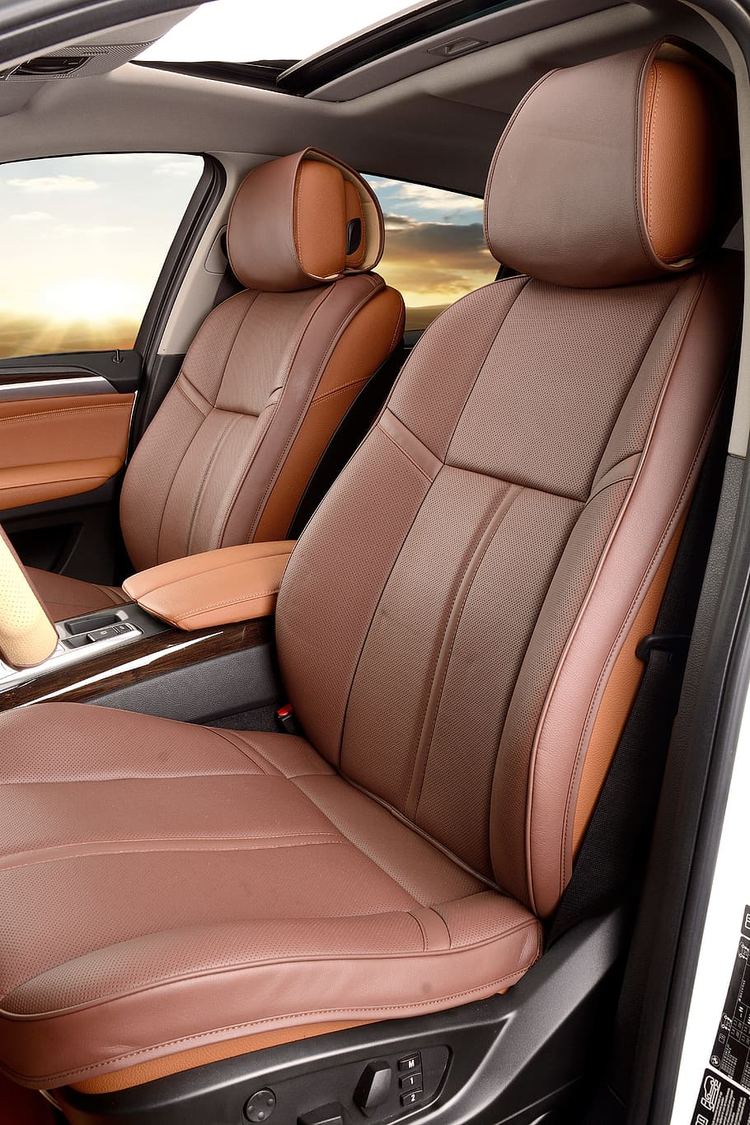
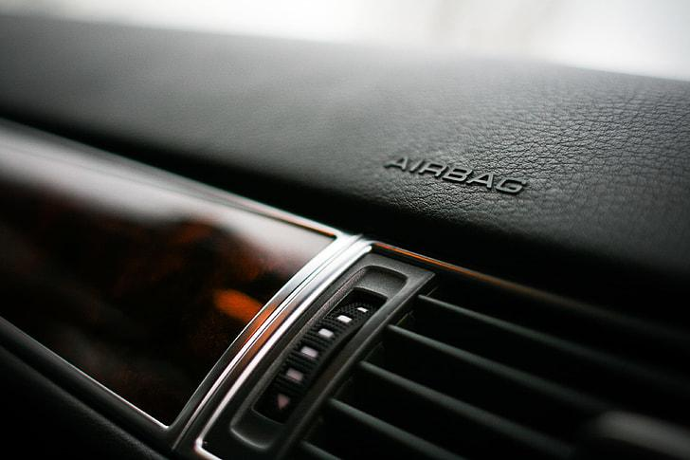
Conclusion and Next Steps
Our AUC shows that our random forest model performs the best when compared to decision tree and SVM
Based on the models that we created we recommend that Carvana focuses on purchasing and marketing cars based on their safety, interior quality, fuel type, and size class
Background
Business Goal
Data and Description
Data Analysis
Methods
Conclusion

Slide 16
Questions?

Slide 17
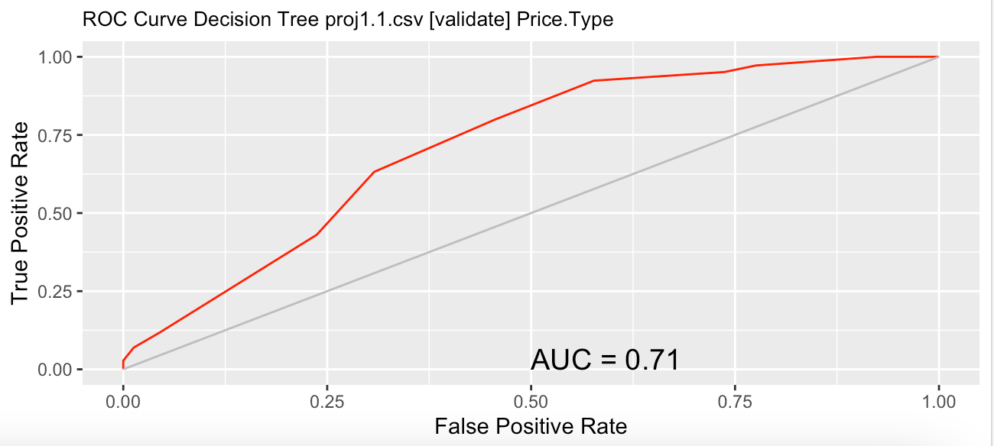
Appendix

Slide 18
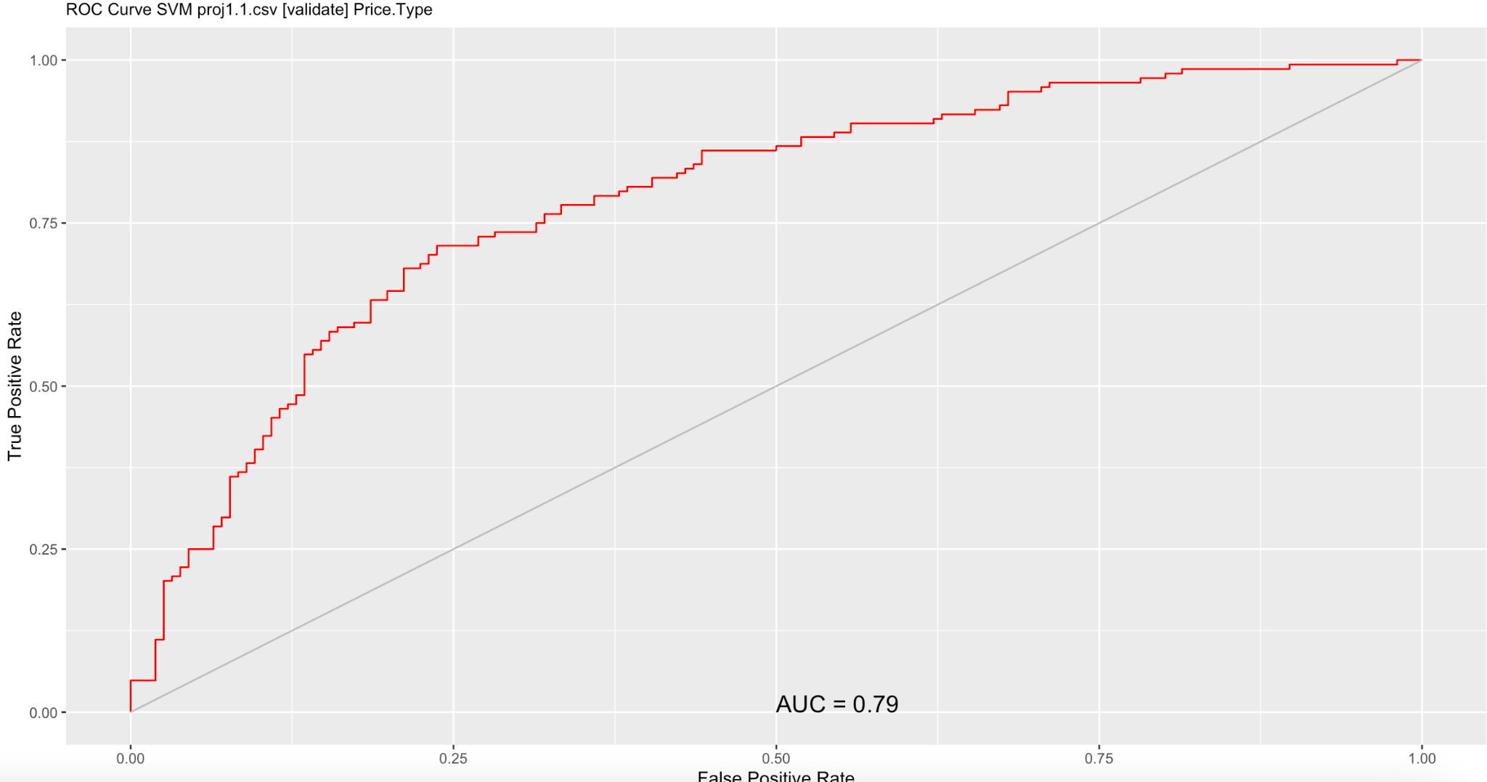

Slide 19
